Slide 1
8 Ways to Successfully Navigate NIH Peer Review and Get an R15 Grant
Dr. Vonda Smith
Scientific Review Officer
October 16, 2017

Slide 2
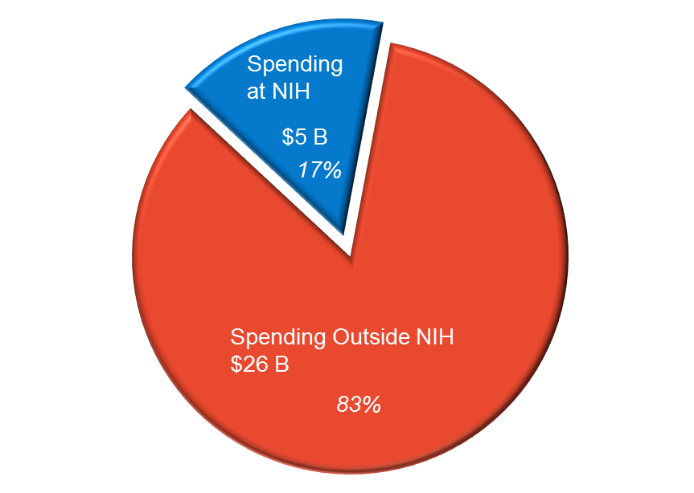
How to Get a Piece of the Pie FY 2016 Enacted: $31.3 Billion

Slide 3
8 Ways to Successfully Navigate NIH Peer Review
Know the Path of a Successful Application

Slide 4
8 Ways to Successfully Navigate NIH Peer Review
Know the Path of a Successful Application
Avoid Common Applicant Pitfalls

Slide 5
8 Ways to Successfully Navigate NIH Peer Review
Know the Path of a Successful Application
Avoid Common Applicant Pitfalls
Help Direct Your Application to the Best Place for Review and Funding

Slide 6
8 Ways to Successfully Navigate NIH Peer Review
Know the Path of a Successful Application
Avoid Common Applicant Pitfalls
Help Direct Your Application to the Best Place for Review and Funding
Understand Who Your Reviewers Are

Slide 7
8 Ways to Successfully Navigate NIH Peer Review
Know the Path of a Successful Application
Avoid Common Applicant Pitfalls
Help Direct Your Application to the Best Place for Review and Funding
Understand Who Your Reviewers Are
Know What Reviewers Are Looking for

Slide 8
8 Ways to Successfully Navigate NIH Peer Review
Know the Path of a Successful Application
Avoid Common Applicant Pitfalls
Help Direct Your Application to the Best Place for Review and Funding
Understand Who Your Reviewers Are
Know What Reviewers Are Looking for
Consider Advice Collected from NIH Reviewers & Staff

Slide 9
8 Ways to Successfully Navigate NIH Peer Review
Know the Path of a Successful Application
Avoid Common Applicant Pitfalls
Help Direct Your Application to the Best Place for Review and Funding
Understand Who Your Reviewers Are
Know What Reviewers Are Looking for
Consider Advice Collected from NIH Reviewers & Staff
Benefit from New Investigator Opportunities

Slide 10
8 Ways to Successfully Navigate NIH Peer Review
Know the Path of a Successful Application
Avoid Common Applicant Pitfalls
Help Direct Your Application to the Best Place for Review and Funding
Understand Who Your Reviewers Are
Know What Reviewers Are Looking for
Consider Advice Collected from NIH Reviewers & Staff
Benefit from New Investigator Opportunities
Ask the Right NIH Person for Help

Slide 11
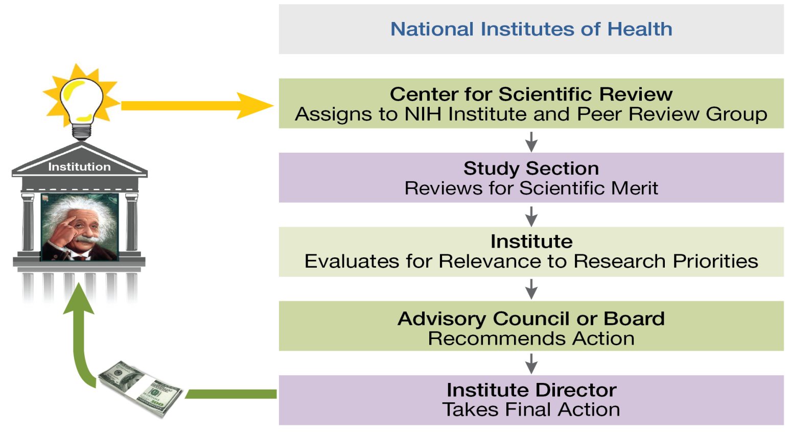
1. Know the Path of a Successful Application
Notes:
In one slide, we’re going to show you How NIH Peer Review Works
NIH has a two-stage review process powered by the input of multiple external experts and other stakeholders. Stage One: Evaluation for Scientific Merit by external scientific experts from academia and industry. Stage Two: Evaluation for Relevance to Research Priorities by the relevant NIH Institute or Center, which consults more senior scientific experts, patients and patient advocates on its Advisory Council.

Slide 12
View the Video – See Real Reviewers in Action
http://www.csr.nih.gov/video/video.asp
Notes:
You’ll see how three reviewers (minimum) are assigned to your application and how they start the discussion of your application.

Slide 13
2. Avoid Common Applicant Pitfalls
Top 8 Pitfalls Producing and Submitting Applications
Using a Small Font
Notes:
Failing to Appreciate Submission Is a Multi-Step Process: your and your institution must have all the required registrations completed and in place at the time of application submission. All applications must be submitted to a Funding Opportunity Announcement (FOA), so you will need to find one of those that fits your application (more on that later). Then you need to download the application package from that FOA, and follow all the instructions in the FOA and the application guide when you are preparing your application. Your responsibility to view your application and track its progress through the system. NIH and CSR first see your application after it clears Grants.gov.

Slide 14
2. Avoid Common Applicant Pitfalls
Top 8 Pitfalls Producing and Submitting Applications
Submitting a New Application but Referring to Previous Review Outcomes or Criticism
Using a Small Font
Notes:
Failing to Appreciate Submission Is a Multi-Step Process: your and your institution must have all the required registrations completed and in place at the time of application submission. All applications must be submitted to a Funding Opportunity Announcement (FOA), so you will need to find one of those that fits your application (more on that later). Then you need to download the application package from that FOA, and follow all the instructions in the FOA and the application guide when you are preparing your application. Your responsibility to view your application and track its progress through the system. NIH and CSR first see your application after it clears Grants.gov.

Slide 15
2. Avoid Common Applicant Pitfalls
Top 8 Pitfalls Producing and Submitting Applications
Overstuffing Your Application
Submitting a New Application but Referring to Previous Review Outcomes or Criticism
Using a Small Font
Notes:
Failing to Appreciate Submission Is a Multi-Step Process: your and your institution must have all the required registrations completed and in place at the time of application submission. All applications must be submitted to a Funding Opportunity Announcement (FOA), so you will need to find one of those that fits your application (more on that later). Then you need to download the application package from that FOA, and follow all the instructions in the FOA and the application guide when you are preparing your application. Your responsibility to view your application and track its progress through the system. NIH and CSR first see your application after it clears Grants.gov.

Slide 16
2. Avoid Common Applicant Pitfalls
Top 8 Pitfalls Producing and Submitting Applications
Producing an Incomplete Application
Overstuffing Your Application
Submitting a New Application but Referring to Previous Review Outcomes or Criticism
Using a Small Font
Notes:
Failing to Appreciate Submission Is a Multi-Step Process: your and your institution must have all the required registrations completed and in place at the time of application submission. All applications must be submitted to a Funding Opportunity Announcement (FOA), so you will need to find one of those that fits your application (more on that later). Then you need to download the application package from that FOA, and follow all the instructions in the FOA and the application guide when you are preparing your application. Your responsibility to view your application and track its progress through the system. NIH and CSR first see your application after it clears Grants.gov.

Slide 17
2. Avoid Common Applicant Pitfalls
Top 8 Pitfalls Producing and Submitting Applications
Not Giving the Instructions Enough Attention
Producing an Incomplete Application
Overstuffing Your Application
Submitting a New Application but Referring to Previous Review Outcomes or Criticism
Using a Small Font
Notes:
Failing to Appreciate Submission Is a Multi-Step Process: you and your institution must have all the required registrations completed and in place at the time of application submission. All applications must be submitted to a Funding Opportunity Announcement (FOA), so you will need to find one of those that fits your application (more on that later). Then you need to download the application package from that FOA, and follow all the instructions in the FOA and the application guide when you are preparing your application. Your responsibility to view your application and track its progress through the system. NIH and CSR first see your application after it clears Grants.gov.

Slide 18
2. Avoid Common Applicant Pitfalls
Top 8 Pitfalls Producing and Submitting Applications
Not Using the Right Application Form
Not Giving the Instructions Enough Attention
Producing an Incomplete Application
Overstuffing Your Application
Submitting a New Application but Referring to Previous Review Outcomes or Criticism
Using a Small Font
Notes:
Failing to Appreciate Submission Is a Multi-Step Process: your and your institution must have all the required registrations completed and in place at the time of application submission. All applications must be submitted to a Funding Opportunity Announcement (FOA), so you will need to find one of those that fits your application (more on that later). Then you need to download the application package from that FOA, and follow all the instructions in the FOA and the application guide when you are preparing your application. Your responsibility to view your application and track its progress through the system. NIH and CSR first see your application after it clears Grants.gov.

Slide 19
2. Avoid Common Applicant Pitfalls
Top 8 Pitfalls Producing and Submitting Applications
Submitting Your Application at the Last Minute
Not Using the Right Application Form
Not Giving the Instructions Enough Attention
Producing an Incomplete Application
Overstuffing Your Application
Submitting a New Application but Referring to Previous Review Outcomes or Criticism
Using a Small Font
Notes:
1 Failing to Appreciate Submission Is a Multi-Step Process: your and your institution must have all the required registrations completed and in place at the time of application submission. All applications must be submitted to a Funding Opportunity Announcement (FOA), so you will need to find one of those that fits your application (more on that later). Then you need to download the application package from that FOA, and follow all the instructions in the FOA and the application guide when you are preparing your application. Your responsibility to view your application and track its progress through the system. NIH and CSR first see your application after it clears Grants.gov.
2 Don’t do this! Give yourself time to submit and re upload if you have errors. All errors must be addressed prior to final submission deadline

Slide 20
2. Avoid Common Applicant Pitfalls
Top 8 Pitfalls Producing and Submitting Applications
Failing to Appreciate Submission Is a Multi-Step Process
Submitting Your Application at the Last Minute
Not Using the Right Application Form
Not Giving the Instructions Enough Attention
Producing an Incomplete Application
Overstuffing Your Application
Submitting a New Application but Referring to Previous Review Outcomes or Criticism
Using a Small Font
Notes:
Failing to Appreciate Submission Is a Multi-Step Process: your and your institution must have all the required registrations completed and in place at the time of application submission. All applications must be submitted to a Funding Opportunity Announcement (FOA), so you will need to find one of those that fits your application (more on that later). Then you need to download the application package from that FOA, and follow all the instructions in the FOA and the application guide when you are preparing your application. Your responsibility to view your application and track its progress through the system. NIH and CSR first see your application after it clears Grants.gov.

Slide 21
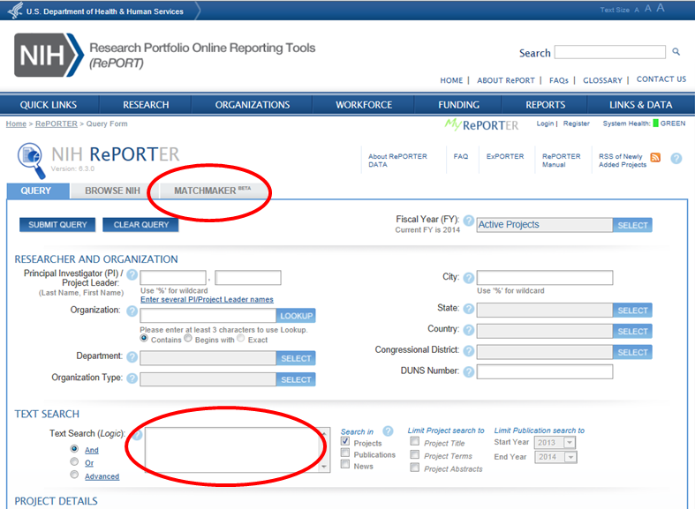
3. Help Direct Your Application to the Best Place for Review and Funding
http://projectreporter.nih.gov/reporter.cfm

Slide 22
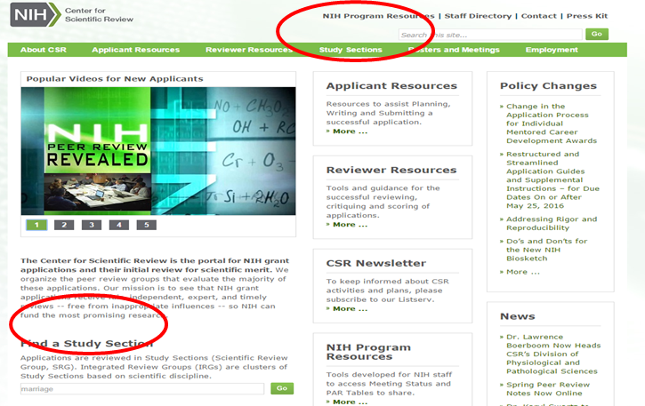
3. Help Direct Your Application to the Best Place for Review and Funding
http://www.csr.nih.gov
Notes:
Best place: Don’t panic if you select the wrong place or someone in the office of sponsored research if you have one was eating a milky way and input the incorrect one.
-Funding agency: If it does not have interest in the area of your application, they will not accept it so please check the announcements carefully to see which ICs are participating
-Best matched study section: If you select a study section that is completely inappropriate, your application is not forced to be reviewed there. We move it and let you know why. Keep in mind fair and accurate review is our mantra1

Slide 23
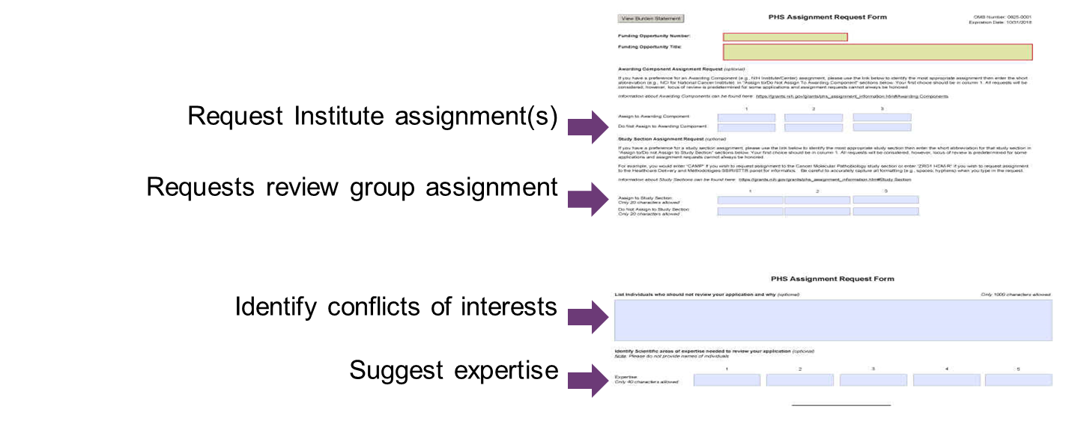
Assignment Request Form
Never Request Specific Reviewers

Slide 24
4. Understand Who Your Reviewers Are
Reviewers:
Have a broad range of scientific expertise and background
Are experts in the field, but maybe not in exact area of your application
Notes:
Can be one or multiple slides…..

Slide 25
4. Understand Who Your Reviewers Are
Check Out Study Section Rosters
www.csr.nih.gov/rosters
Notes:
Of course, it never hurts to cite the research of a reviewer on your panel if it is very germane to your proposed research.

Slide 26
5. Know What Reviewers Are Looking for
Impact
Exciting ideas
Clarity
Realistic aims and timelines -- Don’t be overly ambitious
Brevity with things that everybody knows
Noted limitations of the study
A clean, well-written application

Slide 27
Review Criteria
5. Know What Reviewers Are Looking for
Overall Impact
In addition to the standard criteria for other Rs, R15s must meet the 3 goals of the program: supporting meritorious research, exposing students to hands-on research in eligible environments, and strengthening the research environment of schools that have not been major recipients of NIH support
Core Review Criteria assess research plus the R15 specific addition
Significance
Investigator(s)
Innovation
Approach
Environment
Review criteria each scored from 1-9

Slide 28
Some Review Criteria Are Unique
The R15 specific criteria are incorporated throughout the criteria below:
Significance
Investigator
Approach
Environment
See https://area.nih.gov/ for the specific and section 5.1 in the parent announcement
Notes:
Weighting: If an applicant fails to include students, for example,e but has strong/meritorious research and or good plans to strengthn the environment, this does not offset the lack of students or poor plans to expose the students to hands-on research.

Slide 29
Review of R15 Grant Applications
R15 applications:
Are reviewed together in a special emphasis panel (SEP) or reviewed in a cluster in a regular study section.
Reviewed using review criteria that take into account the goal of these grants.
Notes:
-Reviewed together to reduce comparison to R01s, promote consistent and focused evaluation
-SEP is a separate review meeting
-Clustering a standing/regular study section is self explanatory
-You cannot request a SEP. Review staff decides which option is best for the review
-We also recruit reviewers with a strong appreciation of the R15/AREA program to aid in the review of these applications

Slide 30
AREA/R15 News & resources
New Parent announcement coming December, 2017
See NOT-17-062 https://grants.nih.gov/grants/guide/notice-files/NOT-OD-17-062.html
AREA Program
https://area.nih.gov/
AREA Program FAQs
http://grants.nih.gov/grants/funding/area_faq.htm
Notes:
Michelle Timmerman coordinator: Quick responses

Slide 31
Four Things to Know about Review for Rigor and Transparency For Research Project Grant Applications
5. Know What Reviewers Are Looking for

Slide 32
Four Rigor and Transparency Review Elements Research Project Grant Applications
Can Affect Your Overall Impact Score!
Rigor and Transparency Element | What’s added to the review criteria? | Where in the application?
1. Scientific Premise | Is there a strong scientific foundation for the project? | Research Strategy (Significance)
2. Scientific Rigor | Are there strategies to ensure a robust and unbiased approach? | Research Strategy (Approach)
Notes:
Rigor and transparency do not apply to all applications. See List of Eligible Activity Codes: https://nih-extramural-intranet.od.nih.gov/d/sites/default/files/RigorActivityCodes-20151006.pdf. Also, certain Funding Opportunity Announcements are exempt from rigor, by request from the ICs.

Slide 33
Four Rigor and Transparency Review Elements Projects with Vertebrate Animals and/or Human Subjects
Can Affect Your Overall Impact Score!
Rigor and Transparency Element | Where in the application? | What’s added to the review criteria?
3. Consideration of Relevant Biological Variables, Such as Sex | Research Strategy (Approach) | Are adequate plans to address relevant biological variables, such as sex, included for studies in vertebrate animals or human subjects?

Slide 34
Four Rigor and Transparency Review Elements Projects Involving Key Biological and/or Chemical Resources
Rigor and Transparency Element | Which applications? | Where in the application? | What’s added to the review criteria?
4. Authentication of Key Biological and/or Chemical Resources | Project involving key biological and/or chemical resources | New Attachment | Comment on plans for identifying and ensuring validity of resources.
Won’t Affect Your Overall Impact Score

Slide 35
Additional Criteria Contribute to Overall Impact Scores
Protections for human subjects
Inclusions of women, minorities and children
Appropriate use of vertebrate animals
Management of biohazards
Notes:
These are factored into the Overall impact as appropriate.

Slide 36
6. Consider Advice from NIH Reviewers and Staff

Slide 37
6. Consider Advice from NIH Reviewers and Staff
Articulate each aim and how it advances the overall project

Slide 38
6. Consider Advice from NIH Reviewers and Staff
Articulate each aim and how it advances the overall project
Tell reviewers:
What you will do

Slide 39
6. Consider Advice from NIH Reviewers and Staff
Articulate each aim and how it advances the overall project
Tell reviewers:
What you will do
Why it is important

Slide 40
6. Consider Advice from NIH Reviewers and Staff
Articulate each aim and how it advances the overall project
Tell reviewers:
What you will do
Why it is important
How you will do it

Slide 41
6. Consider Advice from NIH Reviewers and Staff
Articulate each aim and how it advances the overall project
Tell reviewers:
What you will do
Why it is important
How you will do it
How each piece contributes to the whole

Slide 42
6. Consider Advice from NIH Reviewers & Staff
Start with significance

Slide 43
6. Consider Advice from NIH Reviewers & Staff
Start with significance
Current controversies or issues of importance to the field

Slide 44
6. Consider Advice from NIH Reviewers & Staff
Start with significance
Current controversies or issues of importance to the field
Bring something new to the table

Slide 45
6. Consider Advice from NIH Reviewers & Staff
Start with significance
Current controversies or issues of importance to the field
Bring something new to the table
Broad enough to be of interest to general field

Slide 46
6. Consider Advice from NIH Reviewers & Staff
Start with significance
Current controversies or issues of importance to the field
Bring something new to the table
Broad enough to be of interest to general field
Keep it focused and feasible

Slide 47
6. Consider Advice from NIH Reviewers & Staff
Start with significance
Current controversies or issues of importance to the field
Bring something new to the table
Broad enough to be of interest to general field
Keep it focused and feasible
Be self-critical and propose alternatives

Slide 48
6. Consider Advice from NIH Reviewers & Staff
Start with significance
Current controversies or issues of importance to the field
Bring something new to the table
Broad enough to be of interest to general field
Keep it focused and feasible
Be self-critical and propose alternatives
Insert summaries to reinforce key points

Slide 49
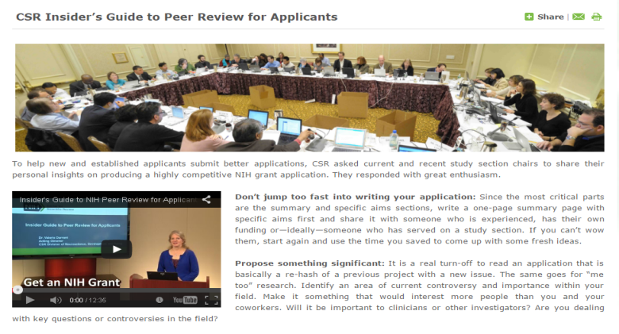
6. Consider Advice from NIH Reviewers and Staff
Check Out the Insider’s Guide to NIH Peer Review for Applicants
http://www.csr.nih.gov/applicantResources/Insider

Slide 50
7. Benefit from New Investigator Opportunities
NIH Will Consider Your Career Status
If you submit an R01 grant application
If you are a New Investigator or Early Stage Investigator
http://grants.nih.gov/grants/new_investigators/
Notes:
Make sure NIH has correct info on your career stage!
New Investigator (NI) is someone who has not yet competed successfully for a substantial NIH independent research award
Early Stage Investigator (ESI) is a New Investigator who is within 10 years of completing the terminal research degree or is within 10 years of completing medical residency (or equivalent). It is possible to get exceptions for interruptions in your career do to the birth of a child and other situations.

Slide 51
7. Benefit from New Investigator Opportunities
Become an Early Career Reviewer
Increase Your Chances of Getting Your First R01 Grant
Notes:
Our Early Career Reviewer Program can give you insights that have been shown to increase a new applicant’s grant success rate.
ECR reviewers -- attend a study section meeting
Serve as the 3rd assigned reviewer for 2-4 applications (Didn’t explain 1-2-3- reviewer roles in Webinar)
Write full critiques for these applications
Participate in the full review meeting

Slide 52
Qualifications for the Early Career Reviewer Program
Demonstrated training and experience in the scientific areas under review as evidenced by:
Two or more years in faculty appointment or the equivalent
An active independent program of research
At least 2 senior authored research publications in peer reviewed journals in the past 2 years
You cannot have an R01 grant or have served on a CSR study section.

Slide 53
How Can I Become an Early Career Reviewer?
Apply! Instructions at www.csr.nih.gov/ECR
If you are accepted, we will:
Place your name in our ECR database
Invite you to serve if your expertise is needed to review particular applications

Slide 54
8. Ask the Right NIH Person for Help
Before You Submit Your Application
A Program Officer at an NIH Institute or Center
Scientific Review Officer
After You Submit
Your Scientific Review Officer
After Your Review
Your Assigned Program Officer
GrantsInfo: GrantsInfo@nih.gov – 301 435-0714
Notes:
Note program officers can give applicants insight into the relevance of an application to their IC’s goals and their possible level of interest in it.
GrantsInfo staff can answer basic questions about the NIH grants and peer review system.

Slide 55
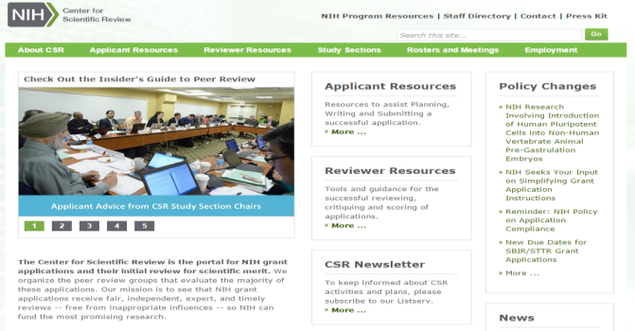
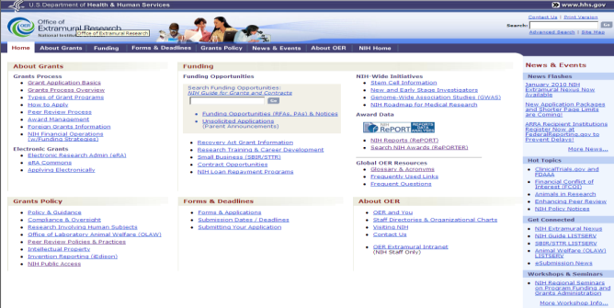
Key NIH Review and Grants Web Sites
NIH Center for Scientific Review
http://www.csr.nih.gov
NIH Office of Extramural Research
http://grants.nih.gov/
Notes:
A lot of critical information and answers to your questions can be found online . . . .

Slide 56
Academic Research Enhancement Award (AREA) Program
Director, AREA Program

Slide 57
Goals of AREA Program
Support small scale research projects
Expose students in eligible environment to hands-on research
Undergraduate (preferably) &/or graduate
Strengthen the research environment of educational institutions that have not been major recipients of NIH research grant funds

Slide 58
Questions to determine fit
Does lab require >$100K/year?
Improve eligible environment?
Stimulate students’ interests? (Will they consider a research career?)
Performed by undergrad /graduate students at the eligible institution?
Notes:
Eligibility does not ensure the R15 is a good fit for a PI’s specific needs.
Does lab require >$100K/year?
Intended to be only NIH research grant
Will project improve eligible environment?
e.g., Are critical parts done elsewhere?
Will project stimulate students’ interests? (Will they consider a research career?)
Will students’ roles in project simulate interest?
Can project pragmatically be performed by undergrad/graduate students at the eligible institution?

Slide 59
What types of students does AREA target?
Undergraduate (preferably) &/or graduate
R15 goals & review criteria do not apply to
High school students
Post-baccalaureate participants
Postdoc, residents, clinical fellows

Slide 60
How should students be involved in AREA grants?
Hands on research
Meaningful activities that will lead them to consider research careers, like
Design, perform & troubleshoot experiments
Present at (lab) meetings
Collect and analyze data
Draft articles

Slide 61
New Parent FOA will be published at end of December
NIH is transitioning to new application forms – FORMS-E
PA-16-200 will be reissued as part of that transition
NOT-OD-17-062

Slide 62
New AREA Webpage
area.nih.gov

Slide 63
AREA Program Resources
Twitter @NIHR15
Facebook NIH AREA Program
Main webpage
https://area.nih.gov
AREA mailbox R151@mail.nih.gov
Institute/Center contacts
http://grants.nih.gov/grants/guide/contacts/parent_R15.html

